Slide 1
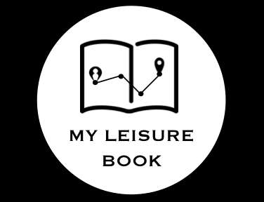
MY LEISURE BOOK
Lola Lejeune, Joseph Kang, Ai King, JhihYang Wu, Hao Zheng, Terry Kim
3 High School Students, 1 Post-Graduate, 1 AI HACK, 1 IT Manager

Slide 2

Nick
Foreigner
Interested in Chinese Culture
Visits China this time

Slide 3

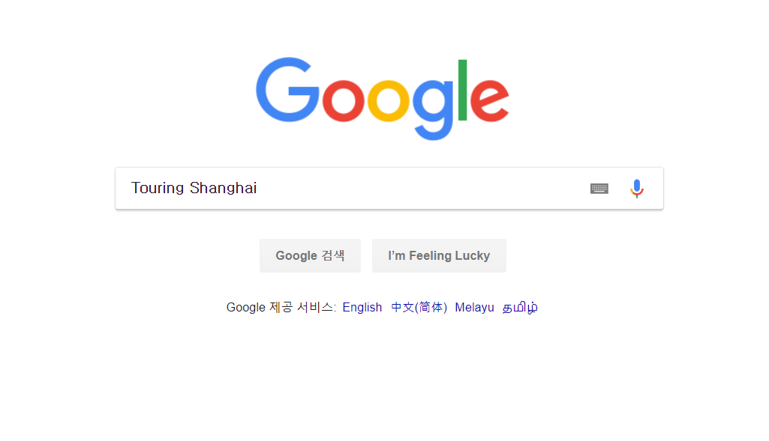

Slide 5
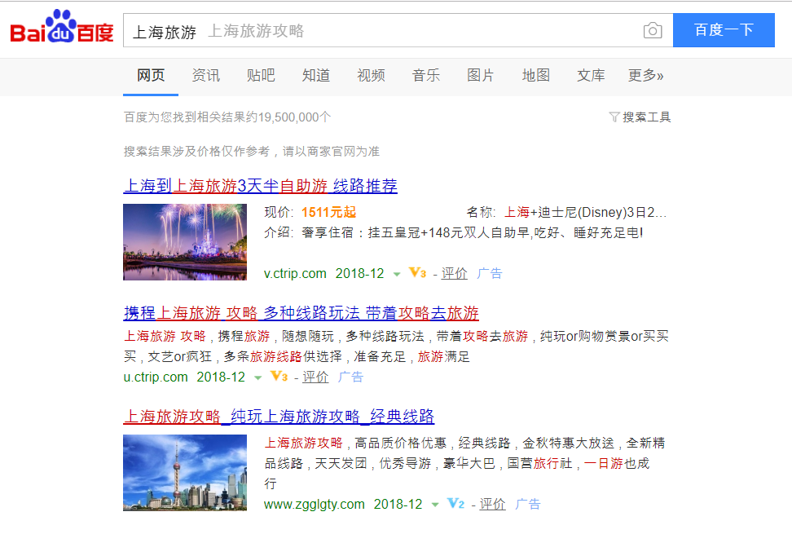

Slide 6
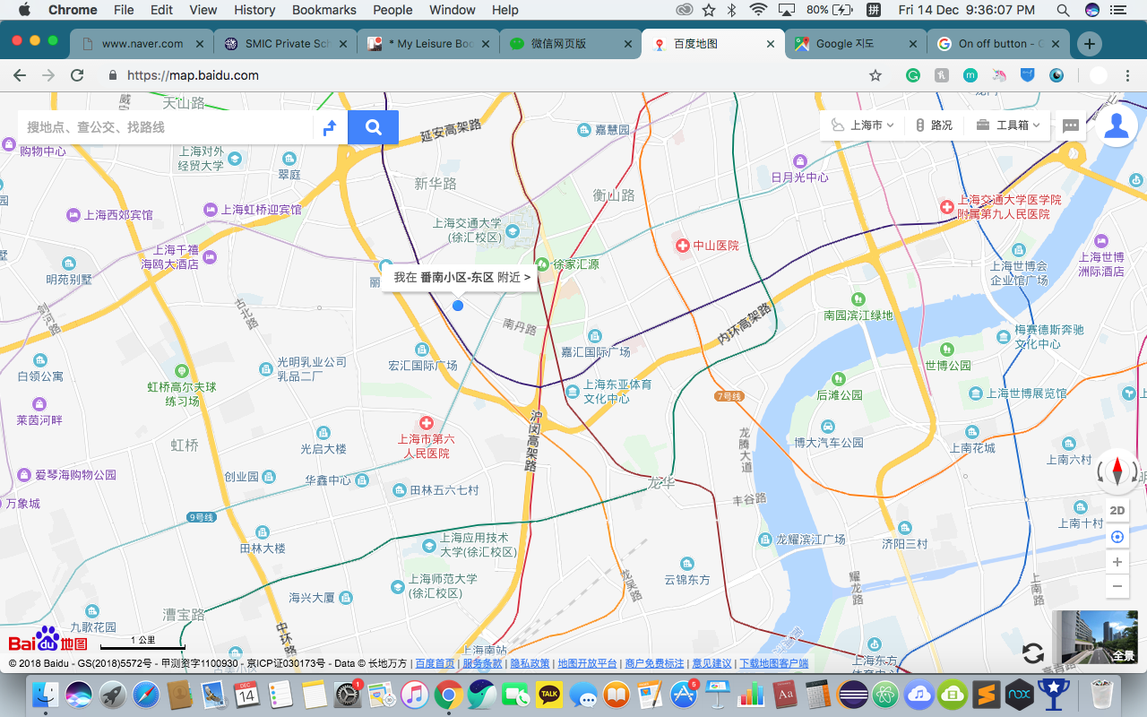
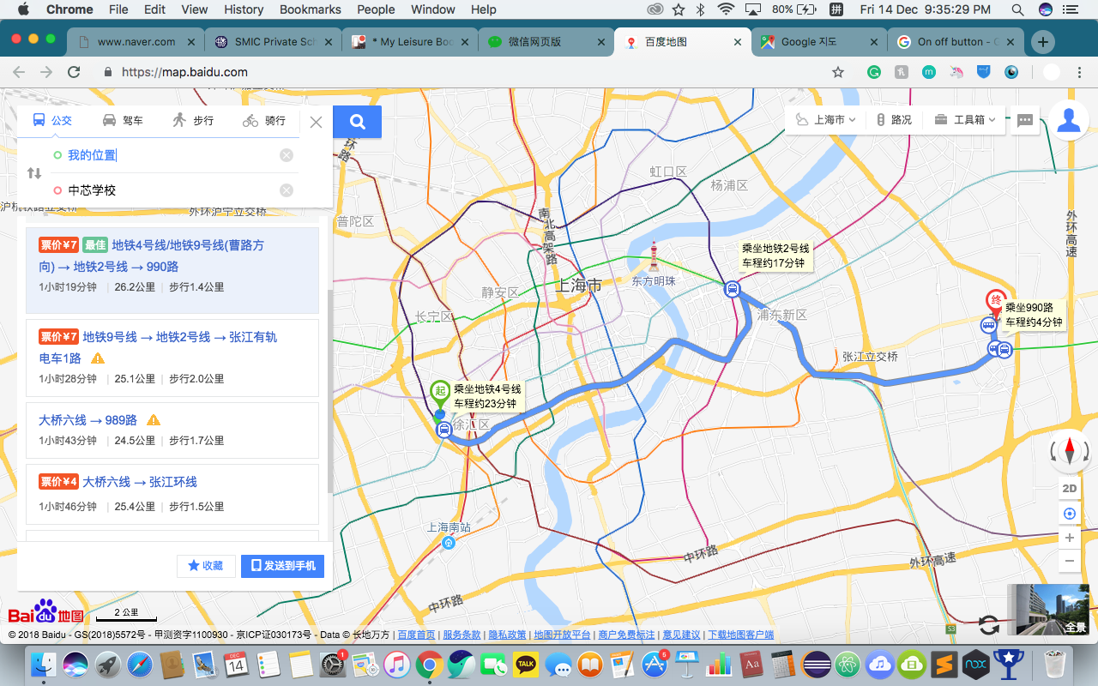
Complicated Unsatisfied

Slide 7
SIMPLE
MEANINGFUL

Slide 8
SIMPLE
PERSONALIZE
Emotion is often intertwined with mood, temperament, personality, disposition, and motivation.
MEANINGFUL

Slide 9


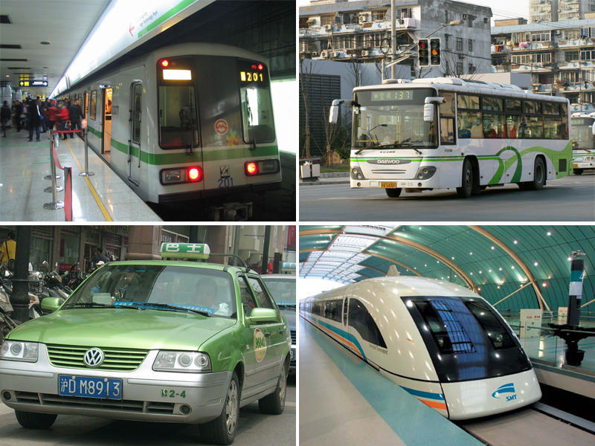

FUNCTION

Slide 10
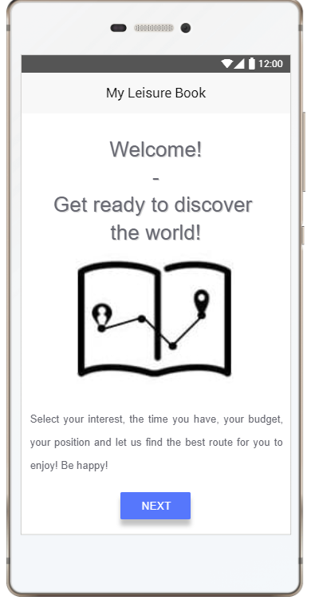
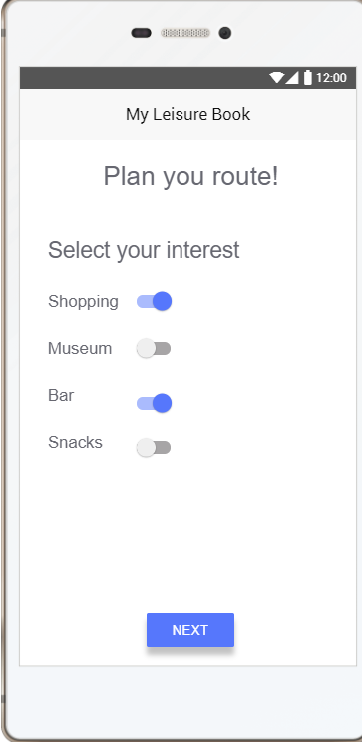
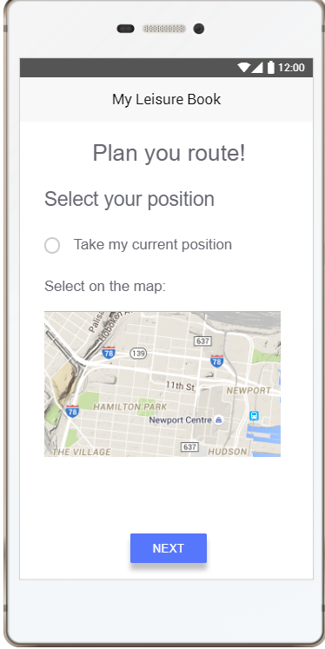
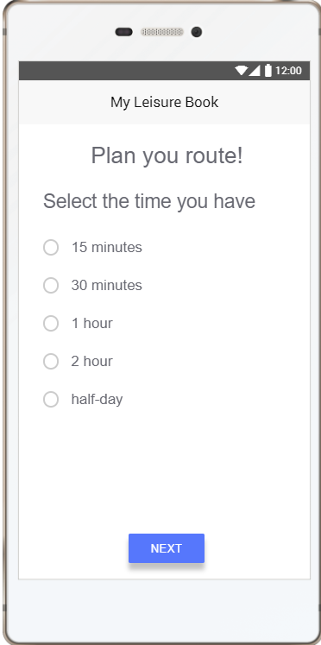

Slide 11
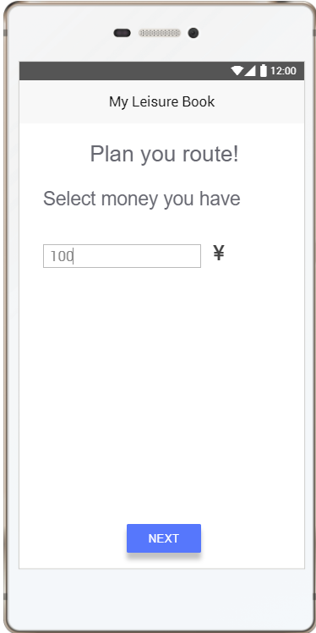
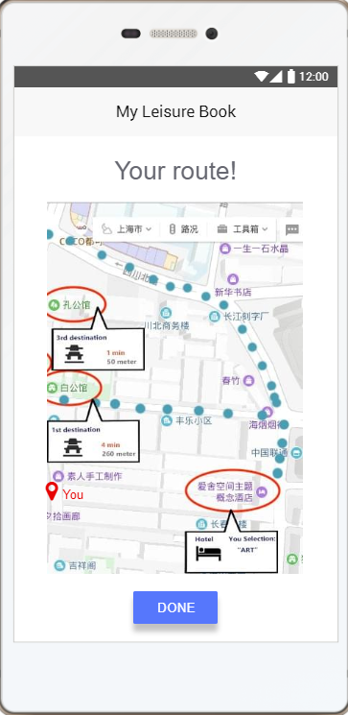
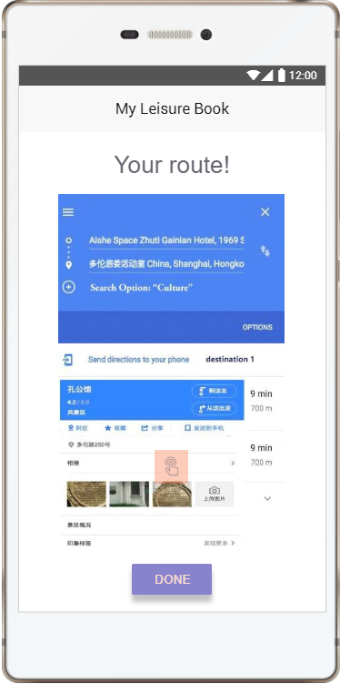

Slide 12
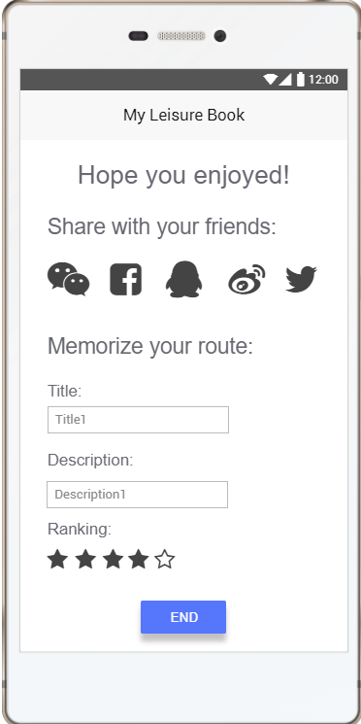
PERSONALIZED
SHARING
EMOTION
EXPERIENCE
PUBLISH

Slide 13

Well, I have “My Leisure Book”
需要推荐吗？

Slide 14
PERFECT, NOW DOES IT WORK?

Slide 15
YES

Slide 16
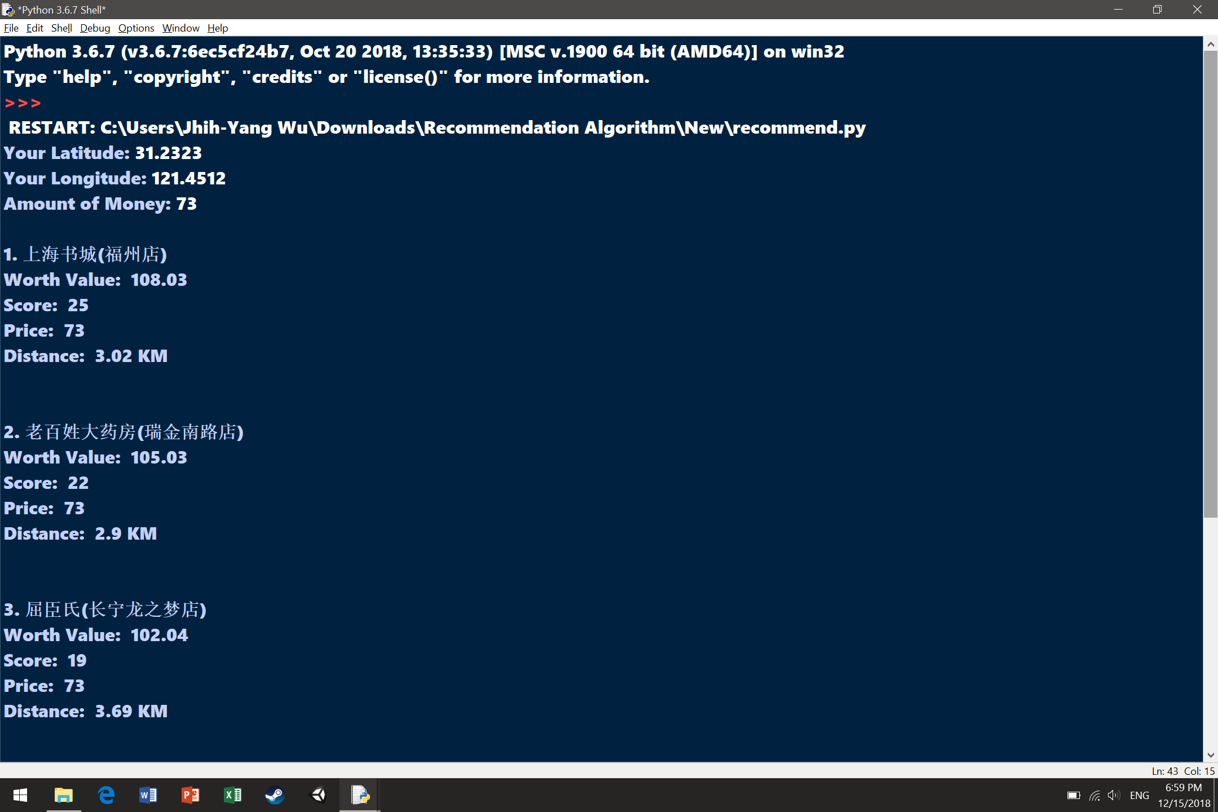

Slide 17
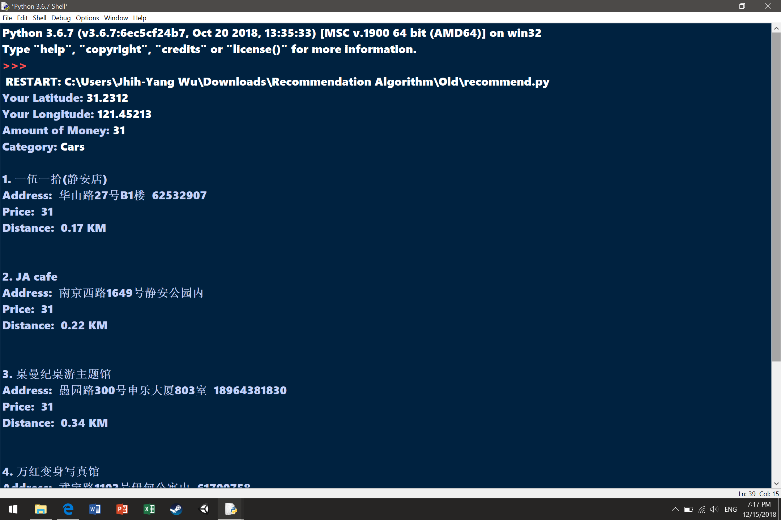

Slide 18
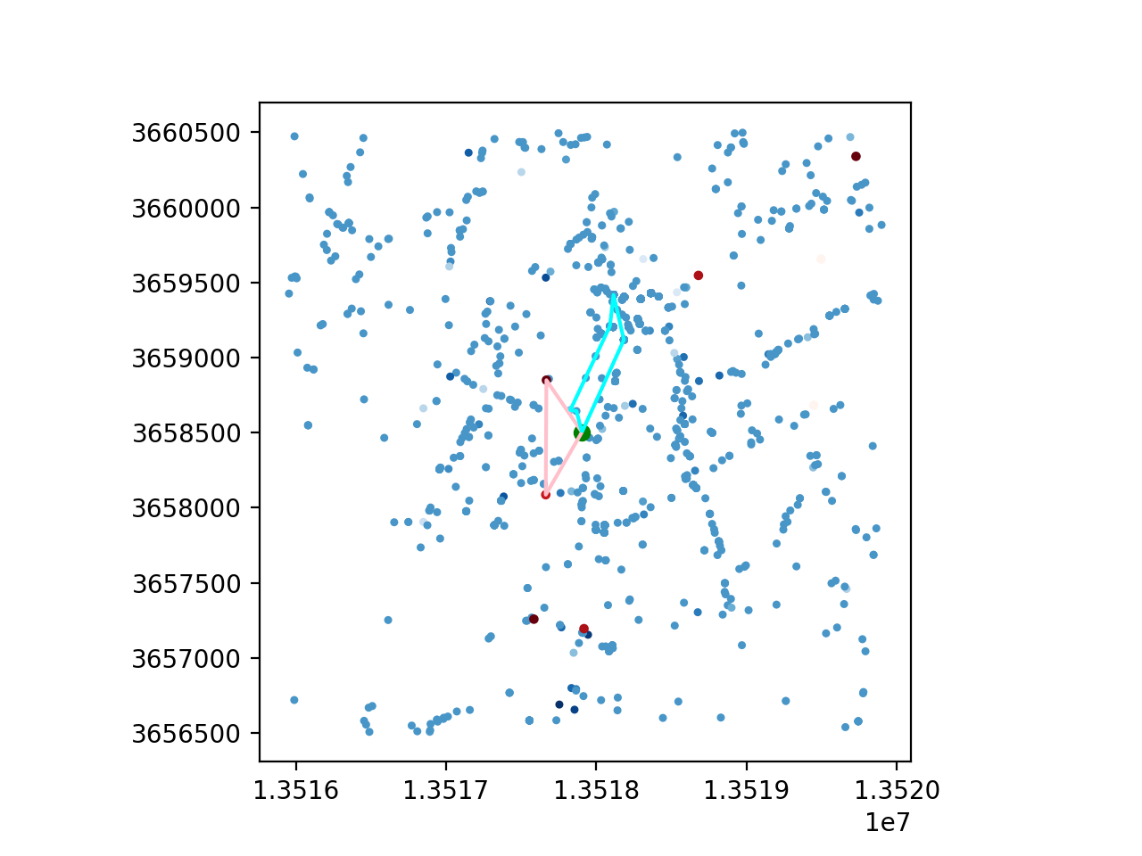
VALUE FROM POI DATA
8760 HOURS

Slide 19
PROFIT?

Slide 20
+NEW

Slide 21
COST STRUCTURE
SOFTWARE DESIGNERS 40%
SERVER SET UP 7%
APP-ADVERTISEMENT (variable) 26%
PROMOTION (variable) 27%

Slide 22
REVENUE
ADVERTISEMENT (ADD MATCH)
IN-APP SERVICE
SPECIAL SERVICE

Slide 23

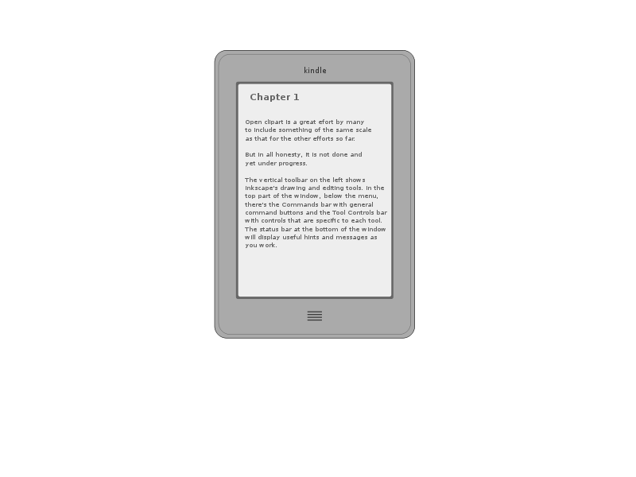
MATCHING

Slide 24
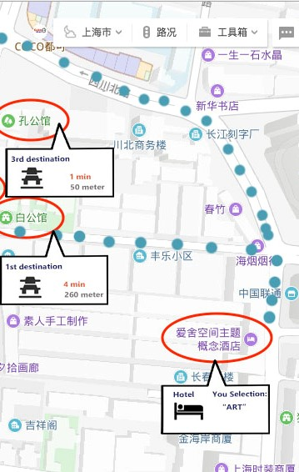



$ 5%
YAHOO OPEN API

Slide 25
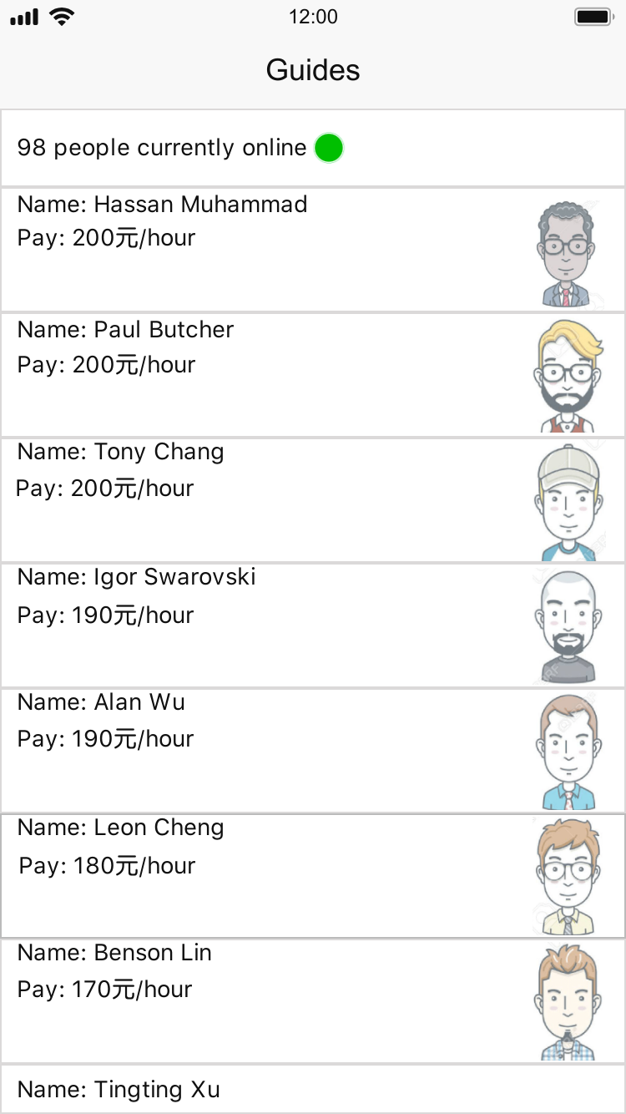
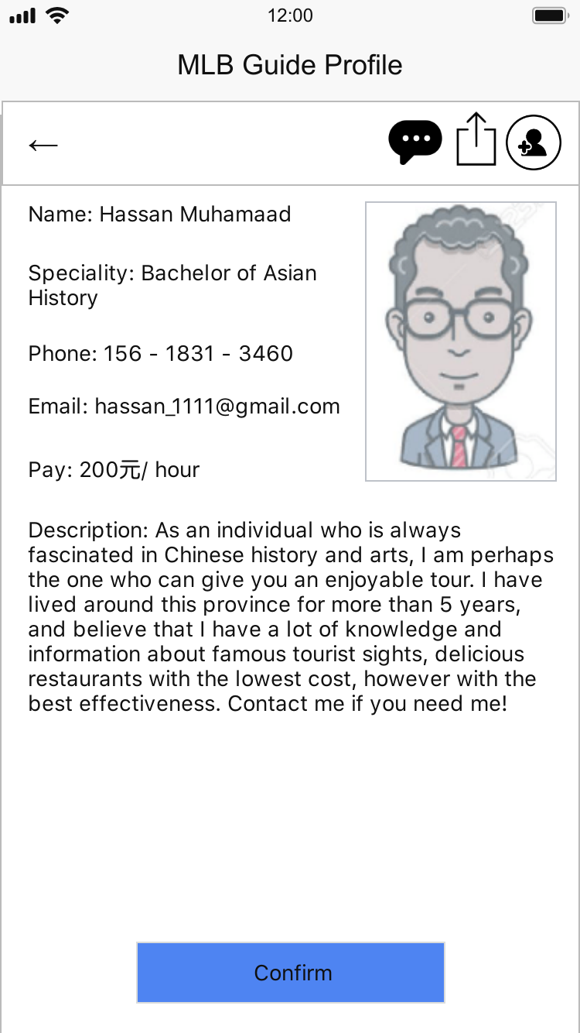
$ 5%

Slide 26
WHY?

Slide 27
Thank You ☺

